Slide 1
SEQUENTIAL CIRCUIT
Flip Flops

Slide 2
GATED D LATCH
Gated D latch is called Transparent Latch.

Slide 3
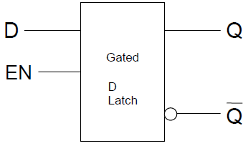
GATED D LATCH

Slide 4
GATED D LATCH TABLE
EN | D
0 | X
1 | 0 | 0 | 1
1 | 1 | 1 | 0

Slide 5
GATED D LATCH TABLE SUMMARY
EN | D
0 | X
1 | 0 | 0
1 | 1 | 1

Slide 6
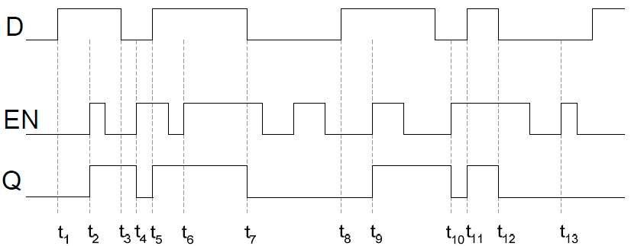
TIMING DIAGRAM D LATCH
EN | D
0 | X
1 | 0 | 0
1 | 1 | 1

Slide 7
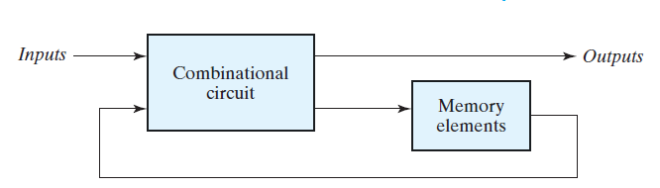
SEQUENTIAL CIRCUIT
Sequential circuit is a combination circuit with memory
Sequential circuit is specified by a time sequence of inputs, outputs, and internal states

Slide 8
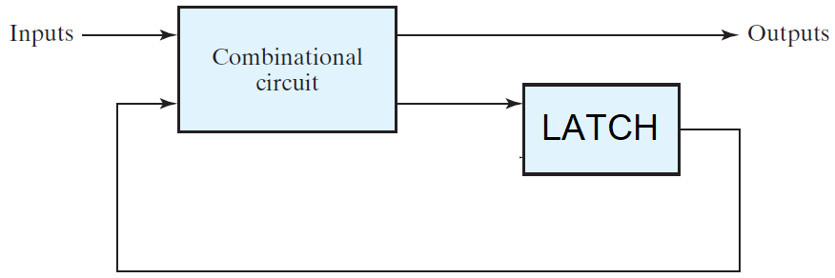
SEQUENTIAL CIRCUIT

Slide 9
TRIGGER
The state of a latch or flip-flop is switched by a change in the control input. This momentary change is called a trigger

Slide 10


CLOCK
Positive Clock Level
Positive Clock Edge
Negative Clock Edge

Slide 11
FLIP FLOP
The latch with pulses in its control input is essentially a FLIP-FLOP
FLIP-FLOP is triggered every time the pulse goes to the logic-1 level

Slide 12
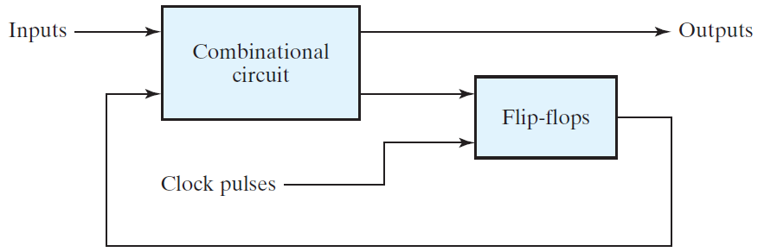
SEQUENTIAL CIRCUIT

Slide 13
Edge Triggered D FLIP FLOP
Master Slave FLIP-FLOP
Positive Edge Triggered FLIP-FLOP

Slide 14
CLOCK
Positive Clock Level
Negative Clock Edge

Slide 15
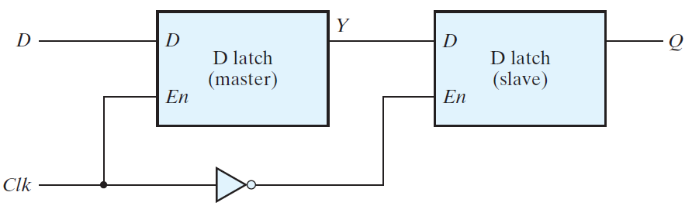
Master Slave D-FLIP-FLOP(NEGATIVE EDGE TRIGGERED)

Slide 16
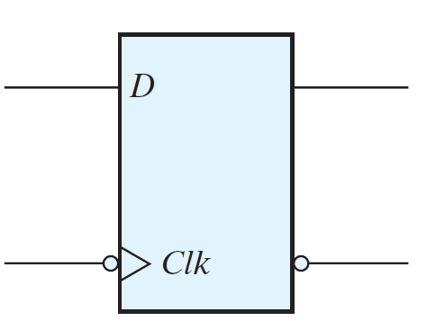
D-FLIP-FLOP (NEGATIVE EDGE TRIGGERED)

Slide 17

Master Slave FLIP-FLOP
MASTER |  |  | SLAVE
CLK | D

Slide 18
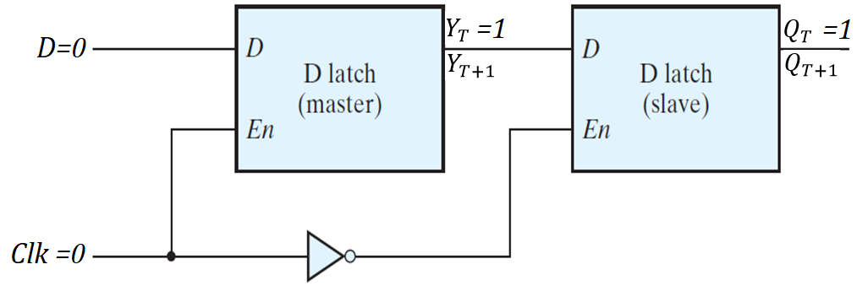

Master Slave FLIP-FLOP
MASTER |  |  | SLAVE
CLK | D
0

Slide 19
Master Slave FLIP-FLOP
MASTER |  |  | SLAVE
CLK | D
0
DISABLE

Slide 20
Master Slave FLIP-FLOP
MASTER |  |  | SLAVE
CLK | D
0 | X
DISABLE

Slide 21
Master Slave FLIP-FLOP
MASTER |  |  | SLAVE
CLK | D
0 | X |  | 1
DISABLE

Slide 22
Master Slave FLIP-FLOP
MASTER |  |  | SLAVE
CLK | D
0 | X |  | 1
DISABLE |  |  | ENABLE

Slide 23
Master Slave FLIP-FLOP
MASTER |  |  | SLAVE
CLK | D
0 | X |  | 1
DISABLE |  |  | ENABLE

Slide 24
Master Slave FLIP-FLOP
MASTER |  |  | SLAVE
CLK | D
0 | X |  | 1 |  | 1
DISABLE |  |  | ENABLE

Slide 25
Master Slave FLIP-FLOP
MASTER |  |  | SLAVE
CLK | D
0 | X |  | 1
DISABLE |  |  | ENABLE

Slide 26
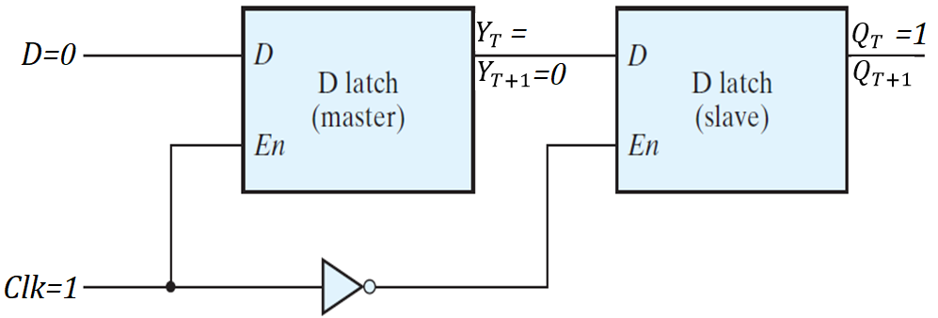
Master Slave FLIP-FLOP
MASTER |  |  | SLAVE
CLK | D
1

Slide 27
Master Slave FLIP-FLOP
MASTER |  |  | SLAVE
CLK | D
1
ENABLE

Slide 28
Master Slave FLIP-FLOP
MASTER |  |  | SLAVE
CLK | D
1 |  |  | 0
ENABLE |  |  | DISABLE

Slide 29
Master Slave FLIP-FLOP
MASTER |  |  | SLAVE
CLK | D
1 |  |  | 0 | X
ENABLE |  |  | DISABLE

Slide 30
Master Slave FLIP-FLOP
MASTER |  |  | SLAVE
CLK | D
1 | 0 |  | 0 | X
ENABLE |  |  | DISABLE

Slide 31
Master Slave FLIP-FLOP
MASTER |  |  | SLAVE
CLK | D
1 | 0 | 0 | 0 | X
ENABLE |  |  | DISABLE

Slide 32
Master Slave FLIP-FLOP
MASTER |  |  | SLAVE
CLK | D
1 | 0 | D | 0 | X
ENABLE |  |  | DISABLE

Slide 33
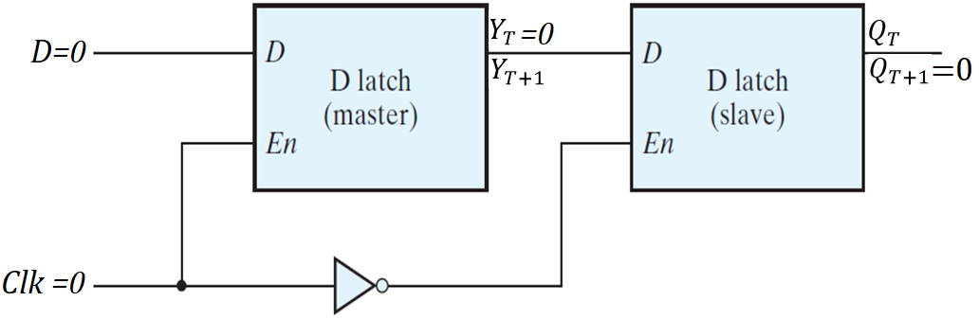
Master Slave FLIP-FLOP
MASTER |  |  | SLAVE
CLK | D
↓ | X |  | ↑ | 0

Slide 34
Master Slave FLIP-FLOP
MASTER |  |  | SLAVE
CLK | D
↓ | X |  | 1

Slide 35
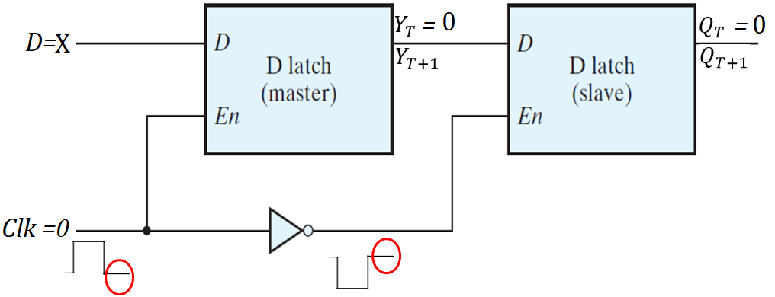
Master Slave FLIP-FLOP
MASTER |  |  | SLAVE
CLK | D
0 | X |  | 1 | 0 | 0
DISABLE |  |  | ENSABLE

Slide 36
Master Slave FLIP-FLOP

Slide 37
D-FLIP-FLOP (NEGATIVE EDGE TRIGGERED)
Dynamic Input Indicator: FF only changes on Edge

Slide 38
JK-FLIP-FLOP
JK Flip-flop is similar to the SR Flip-flop with no INVALID CONDITION
*SR Flip-flop(SR GATED Latch with clock pulse on enable)
JK Flip Flop perform three operations
SET
RESET
COMPLEMENT

Slide 39
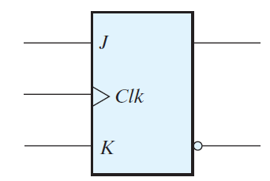
LOGIC SYMBOL (JK-FLIP-FLOP)

Slide 40
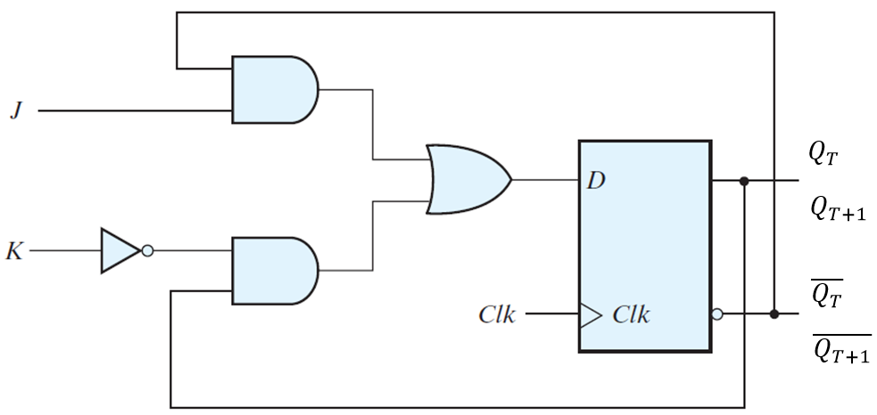
JK-FLIP-FLOP Using D-FLIP FLOP

Slide 41
CHARACTERISTIC EQUATION

Slide 42
TRUTH TABLE (JK-FLIP-FLOP)
0 | 0
0 | 1
1 | 0
1 | 1

Slide 43
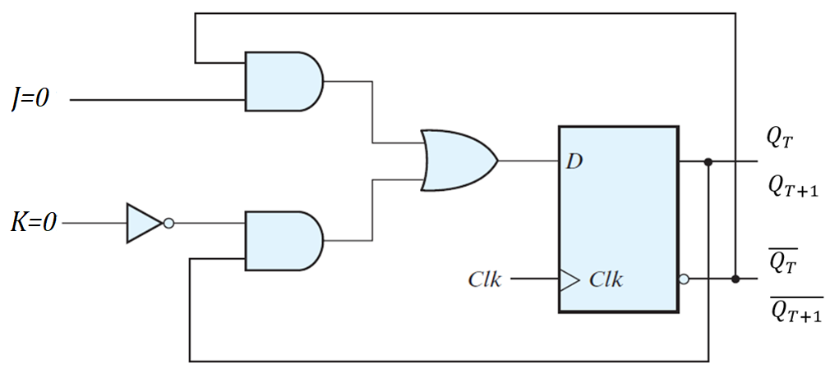
JK-FLIP-FLOP
0 | 0

Slide 44
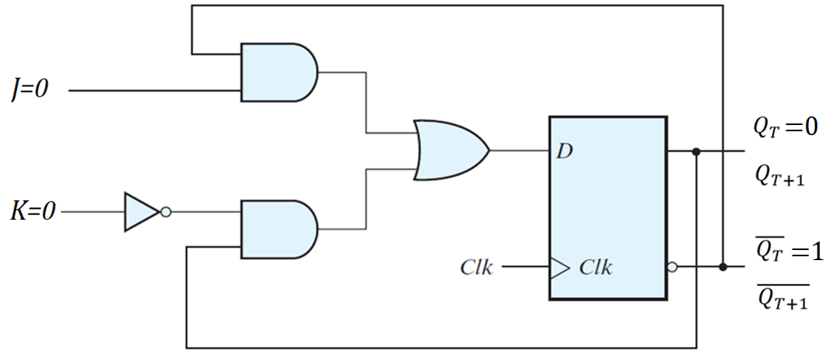
JK-FLIP-FLOP
0 | 0

Slide 45
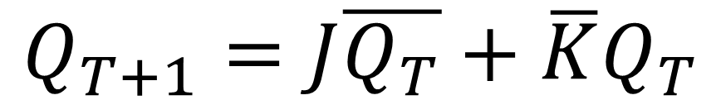
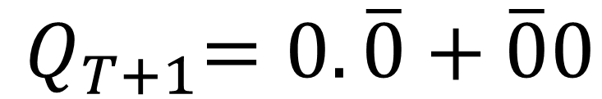
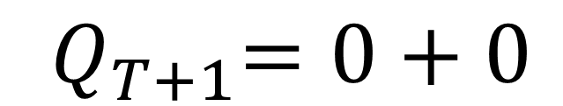
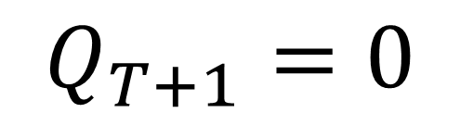
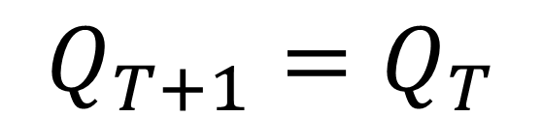
CHARACTERISTIC EQUATION
0 | 0

Slide 46
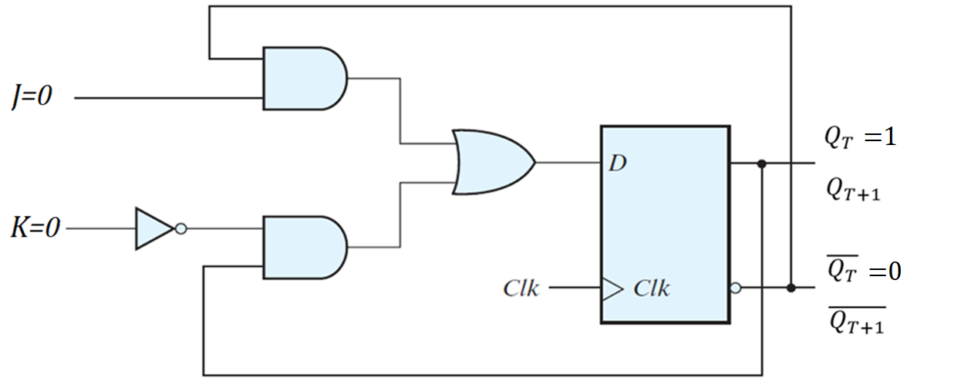
JK-FLIP-FLOP
0 | 0

Slide 47
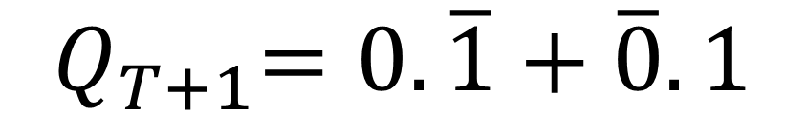
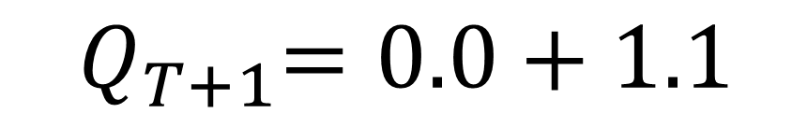
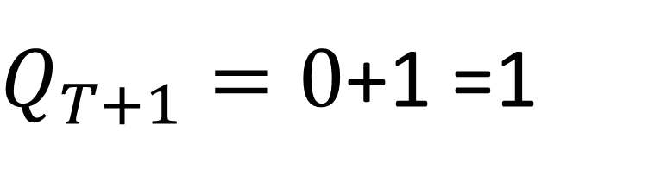
CHARACTERISTIC EQUATION
0 | 0

Slide 48
COMPARING CASE I & II when J=0 , K=0
0 | 0
0 | 0

Slide 49
TRUTH TABLE
0 | 0
0 | 1
1 | 0
1 | 1

Slide 50
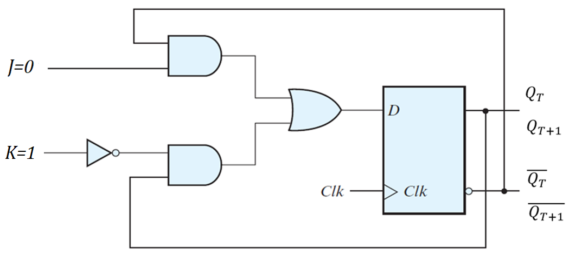
JK-FLIP-FLOP
0 | 1

Slide 51
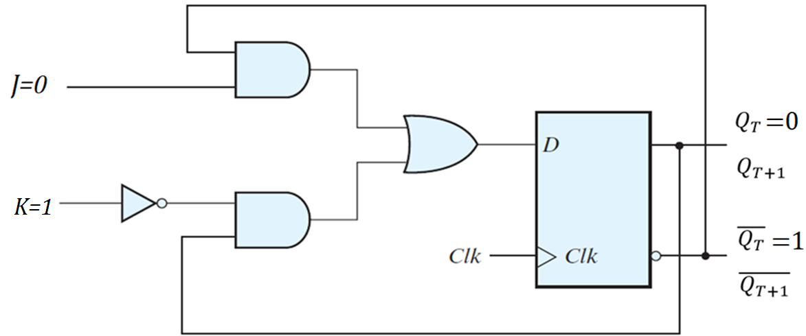
JK-FLIP-FLOP
0 | 1

Slide 52
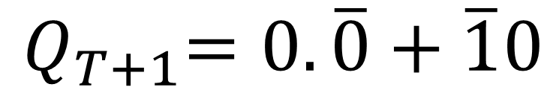
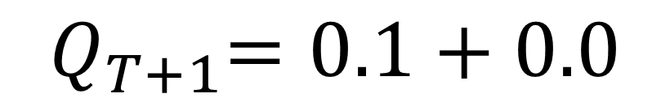
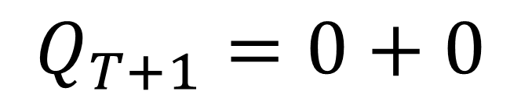
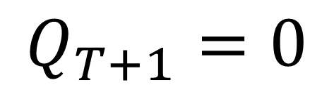
CHARACTERISTIC EQUATION
0 | 1 | 0 | 1

Slide 53

JK-FLIP-FLOP
0 | 1

Slide 54
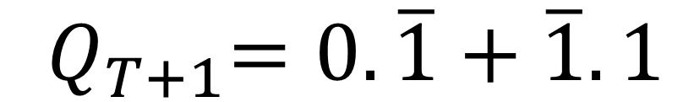
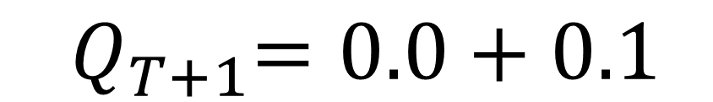
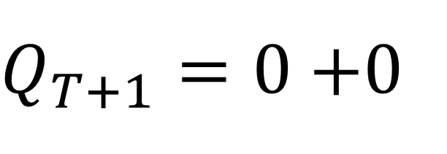
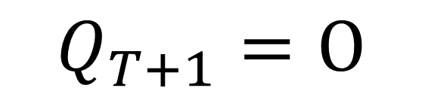
CHARACTERISTIC EQUATION
0 | 1 | 0 | 1

Slide 55
COMPARING CASE I & II when J=0 , K=1
0 | 1 | 0 | 1
0 | 1 | 0 | 1

Slide 56
TRUTH TABLE
0 | 0
0 | 1 | 0 | 1
1 | 0
1 | 1

Slide 57

JK-FLIP-FLOP
1 | 0

Slide 58

JK-FLIP-FLOP
1 | 0

Slide 59
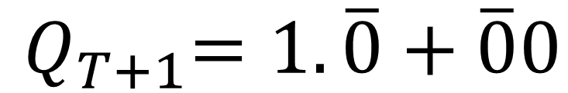
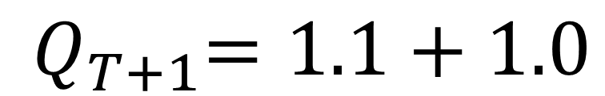
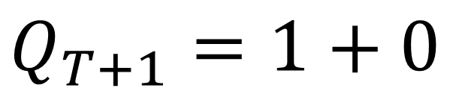
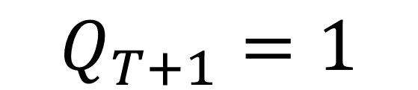
CHARACTERISTIC EQUATION
1 | 0

Slide 60

JK-FLIP-FLOP
1 | 0

Slide 61
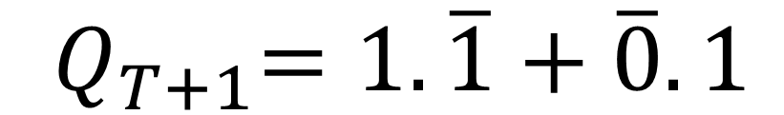
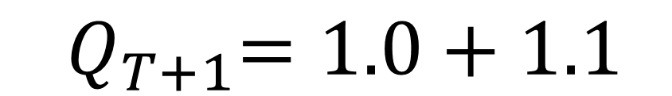
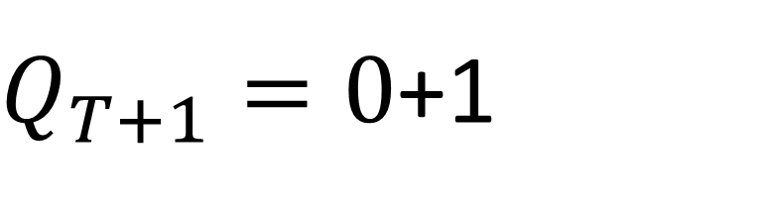
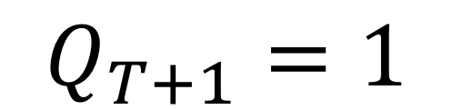
CHARACTERISTIC EQUATION
1 | 0

Slide 62
COMPARING CASE I & II when J=1 , K=0
1 | 0
1 | 0

Slide 63
TRUTH TABLE
0 | 0
0 | 1 | 0 | 1
1 | 0 | 1 | 0
1 | 1

Slide 64
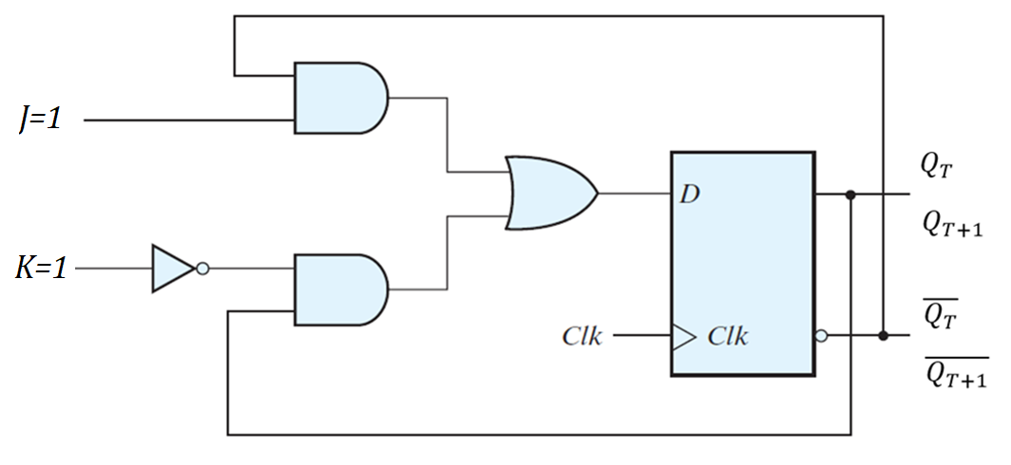
JK-FLIP-FLOP
1 | 1

Slide 65

JK-FLIP-FLOP
1 | 1

Slide 66
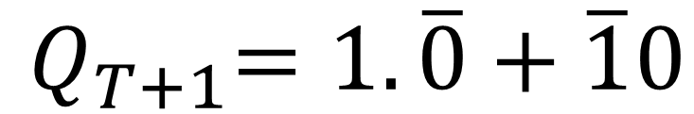
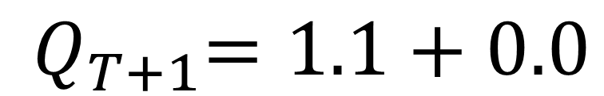
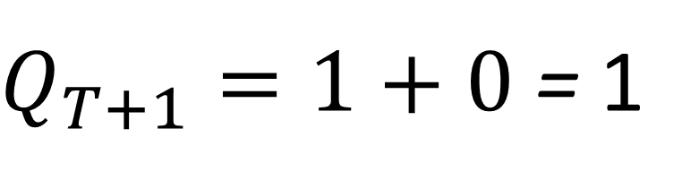
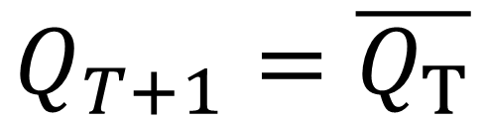
CHARACTERISTIC EQUATION
1 | 1

Slide 67

JK-FLIP-FLOP
1 | 1

Slide 68
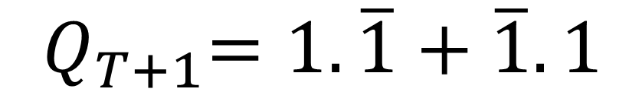
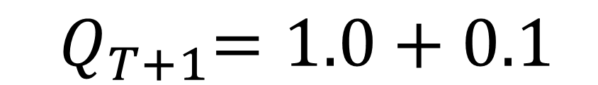
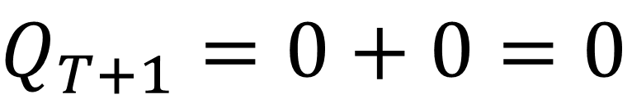

CHARACTERISTIC EQUATION
1 | 1

Slide 69
COMPARING CASE I & II when J=1 , K=1
1 | 1
1 | 1

Slide 70
TRUTH TABLE
0 | 0
0 | 1 | 0 | 1
1 | 0 | 1 | 0
1 | 1

Slide 71
CHARACTERISTIC TABLE
 |  |  |  | COMMENT
0 | 0 |  |  | NO CHANGE
0 | 1 | 0 | 1 | RESET
1 | 0 | 1 | 0 | SET
1 | 1 |  |  | TOGGLE/ COMPLEMENT

Slide 72
CHARACTERISTIC TABLE
 |  |  | COMMENT
0 | 0 |  | NO CHANGE
0 | 1 | 0 | RESET
1 | 0 | 1 | SET
1 | 1 |  | TOGGLE/ COMPLEMENT

Slide 73
CHARACTERISTIC TABLE
0 | 0
0 | 1 | 0
1 | 0 | 1
1 | 1

Slide 74
T-FLIP FLOP
The T or "toggle" flip-flop
T input is low, the flip-flop holds the previous value.
T input is high, the T flip-flop changes toggles old state ("toggles") whenever the clock input is strobed.
Used in binary counters, frequency dividers, and general binary addition devices.

Slide 75

LOGIC SYMBOL (T-FLIP-FLOP)

Slide 76

T-FLIP-FLOP Using D-FLIP FLOP

Slide 77


CHARACTERISTIC EQUATION

Slide 78
TRUTH TABLE (T-FLIP-FLOP)
0
1

Slide 79

T-FLIP-FLOP
0

Slide 80

T-FLIP-FLOP
0

Slide 81




CHARACTERISTIC EQUATION
0 | 0 | 1

Slide 82

T-FLIP-FLOP
0

Slide 83



CHARACTERISTIC EQUATION
0 | 1 | 0

Slide 84
COMPARING CASE I & II when T=0
0
0

Slide 85
TRUTH TABLE (T-FLIP-FLOP)
0
1

Slide 86

T-FLIP-FLOP
1

Slide 87

T-FLIP-FLOP
1

Slide 88



CHARACTERISTIC EQUATION
1 | 1 | 0

Slide 89

T-FLIP-FLOP
1

Slide 90



CHARACTERISTIC EQUATION
1 | 0 | 1

Slide 91
COMPARING CASE I & II when T=1
1
1

Slide 92
TRUTH TABLE (T-FLIP-FLOP)
0
1

Slide 93
TRUTH TABLE (T-FLIP-FLOP)
 |  |  | COMMENT
0 |  |  | NO CHANGE
1 |  |  | TOGGLE

Slide 94
Flip Flop
D-Type Positive Edge Triggered

Slide 95
Master Slave D-FLIP-FLOP(NEGATIVE EDGE TRIGGERED)

Slide 96

D-FLIP-FLOP (POSITIVE EDGE TRIGGERED)

Slide 97

D-FLIP-FLOP (POSITIVE EDGE TRIGGERED)

Slide 98
D-FLIP-FLOP (POSITIVE EDGE TRIGGERED)
Three SR LATCH

Slide 99
D-FLIP-FLOP (POSITIVE EDGE TRIGGERED)
Three SR LATCH
TOP
OUTPUT
BOTTOM

Slide 100
SR LATCH TABLE
 |  |  |  | COMMENT
0 | 0 | 1 | 1 | INVALID CONDITION
0 | 1 | 1 | 0 | SET
1 | 0 | 0 | 1 | RESET
1 | 1 |  |  | NO CHANGE

Slide 101
SR LATCH TABLE
 |  |  | COMMENT
0 | 0 | RC | INVALID CONDITION
0 | 1 | 1 | SET
1 | 0 | 0 | RESET
1 | 1 |  | NO CHANGE

Slide 102

D-FLIP-FLOP (POSITIVE EDGE TRIGGERED)
Clk | D
0

Slide 103

D-FLIP-FLOP (POSITIVE EDGE TRIGGERED)
Clk | D
0

Slide 104
TRUTH TABLE
0 | X
1 | X
 | 0
 | 1

Slide 105
TRUTH TABLE
0 | X
1 | X
 | 0
 | 1

Slide 106

D-FLIP-FLOP (POSITIVE EDGE TRIGGERED)
D | Clk
0

Slide 107
TRUTH TABLE
0 | X
1
 | 0 | 0 | 1

Slide 108

D-FLIP-FLOP (POSITIVE EDGE TRIGGERED)
Clk | D
1

Slide 109
TRUTH TABLE
0 | X
1 | X
 | 0 | 0 | 1
 | 1

Slide 110

D-FLIP-FLOP (POSITIVE EDGE TRIGGERED)
Clk | D
0

Slide 111
TRUTH TABLE
0 | X
1 | X
 | 0 | 0 | 1
 | 1

Slide 112

D-FLIP-FLOP (POSITIVE EDGE TRIGGERED)
D | Clk
1

Slide 113
TRUTH TABLE
0 | X
1 | X
 | 0 | 0 | 1
 | 1 | 1 | 0

Slide 114

D-FLIP-FLOP (POSITIVE EDGE TRIGGERED)
Clk | D
1

Slide 115
TRUTH TABLE
0 | X
1 | X
 | 0 | 0 | 1
 | 1 | 1 | 0

Slide 116
TRUTH TABLE
 |  |  |  | COMMENT
0 | X |  |  | NO CHANGE
1 | X |  |  | NO CHANGE
 | 0 | 0 | 1 | RESET
 | 1 | 1 | 0 | SET

Slide 117
D-FLIP FLOP with ASYNCHRONOUS RESET

Slide 118
D-FLIP-FLOP (POSITIVE EDGE TRIGGERED)

Slide 119

BLOCK DIAGRAM (D-FLIP FLOP with DIRECT INPUT)

Slide 120
D-FLIP FLOP with DIRECT INPUT
Force Flip Flop to Particular state independently of the CLOCK
PRESET/ DIRECT SET: Set Flip-Flop to 1
CLEAR/ DIRECT RESET: Clears Flip-Flop to 0
Usage: Digital systems are Cleared/PRESET before CLOCKED OPERATION

Slide 121

D-FLIP FLOP AYSNCHRONOUS RESET

Slide 122

D-FLIP FLOP AYSNCHRONOUS RESET

Slide 123
FUNCTION TABLE (D FLIPFLOP with DIRECT INPUTS)
1 |  | 0 | 0 | 1
1 |  | 1 | 1 | 0

Slide 124

D-FLIP FLOP AYSNCHRONOUS RESET

Slide 125
TABLE (D FLIPFLOP with DIRECT INPUTS
0 | X | X
1 |  | 0 | 0 | 1
1 |  | 1 | 1 | 0

Slide 126
TABLE (D FLIPFLOP with DIRECT INPUTS
 |  |  |  | COMMENT
0 | X | X | 0 | Asynchronous Reset
1 |  | 0 | 0 | Clocked Reset
1 |  | 1 | 1 | Clocked Set

